Slide 1
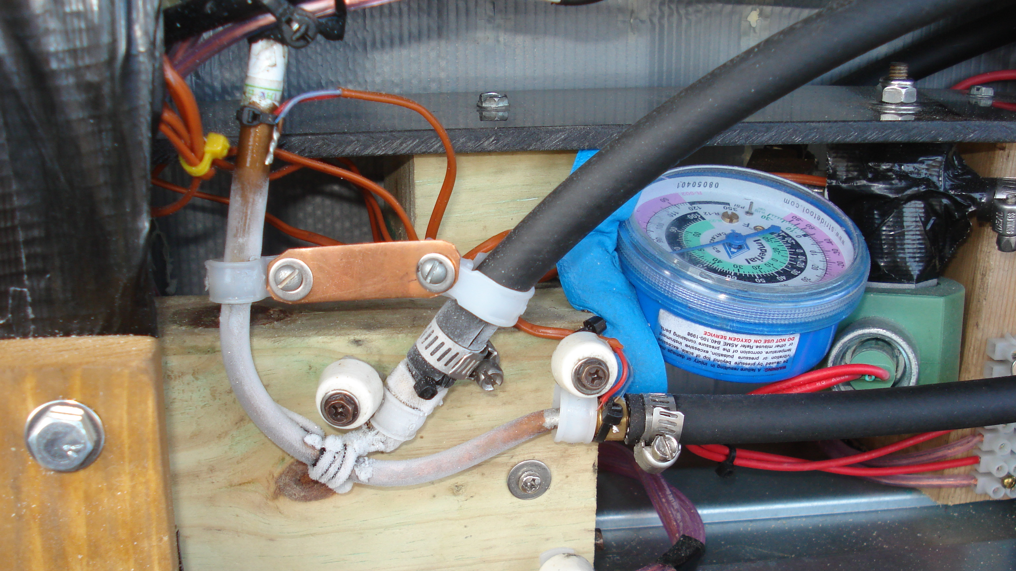
Safety is Paramount
Frostbite is a real possibility if precautions are not taken

Slide 2
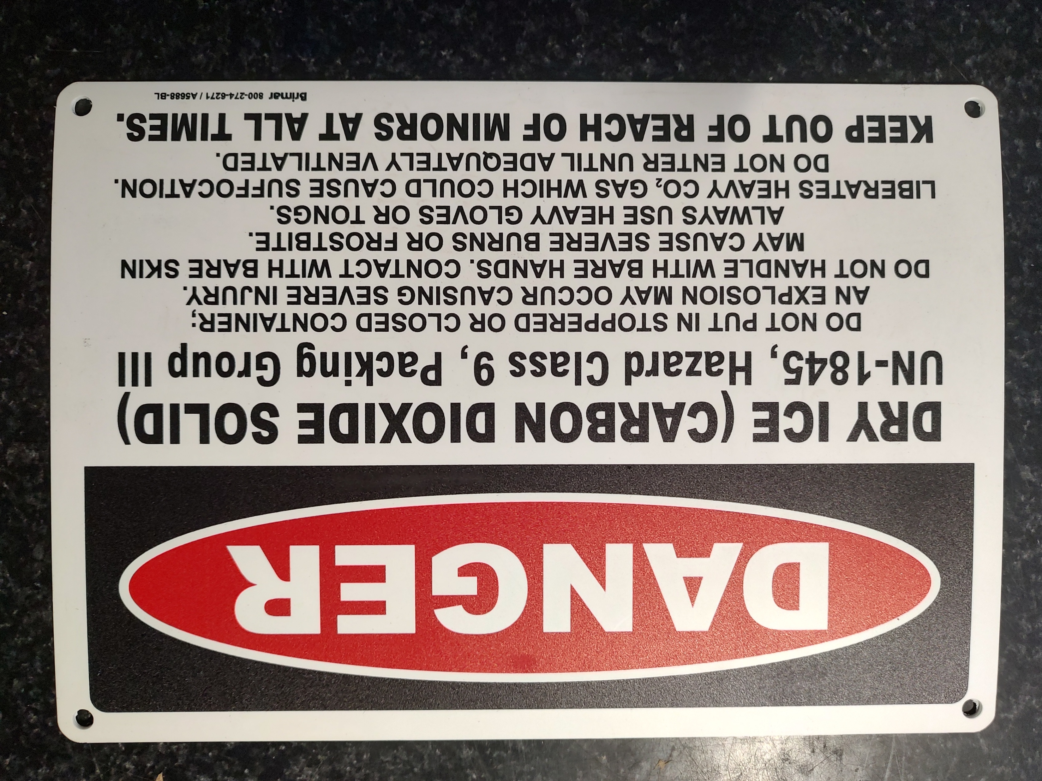
Education is essential

Slide 3
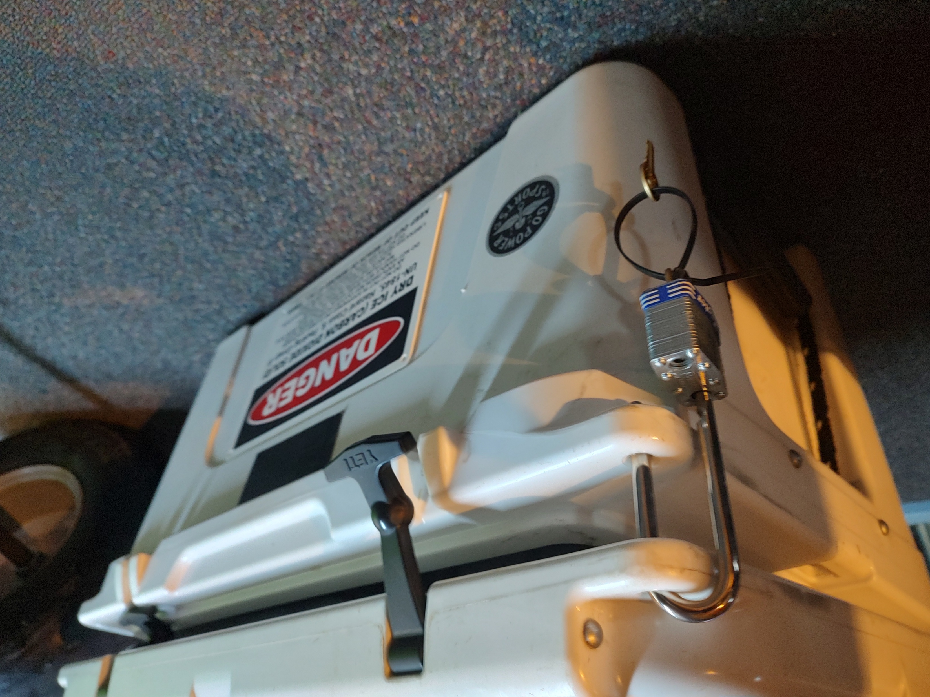
The lock Keeps fingers away from -100°F

